Slide 1

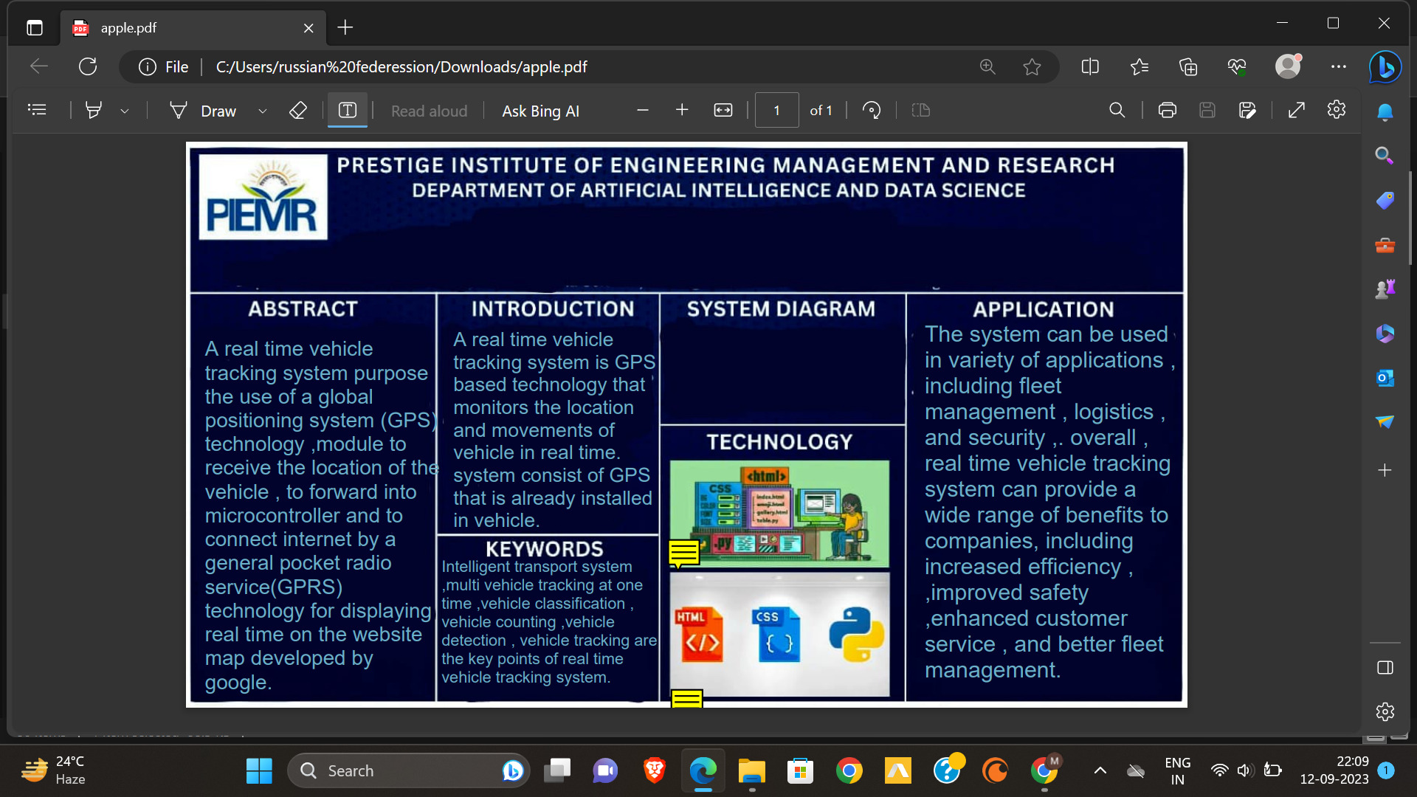
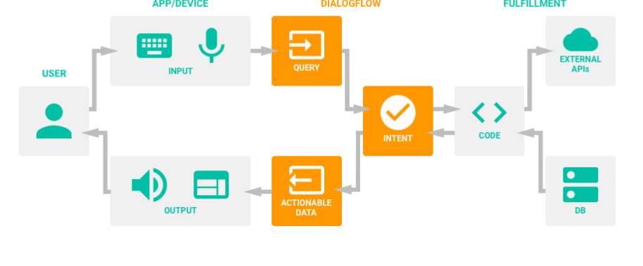
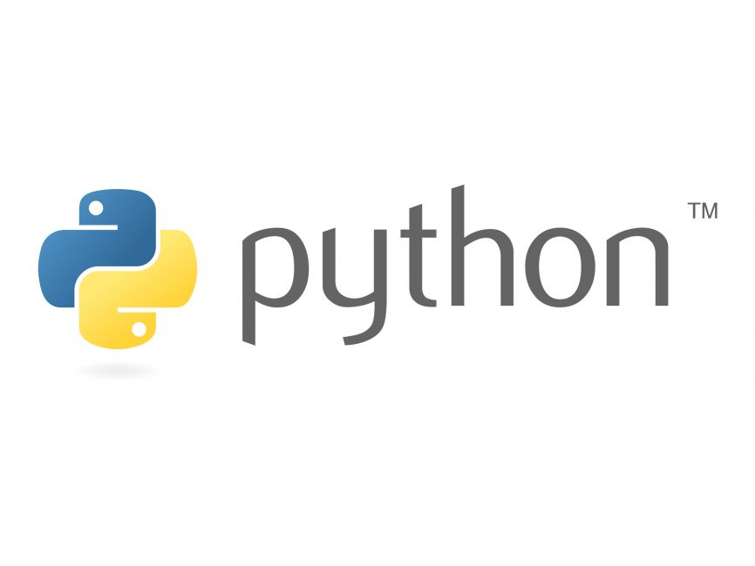
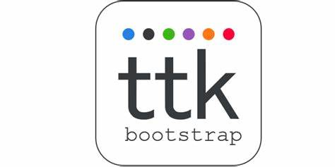
PRESTIGE INSTITUTE OF ENGINEERING MANAGEMENT AND RESEARCH
DEPARTMENT OF ARTIFICIAL INTELLIGENCE AND DATA SCIENCE
Chatbot Song Recommendation System
Guided by: Dr. Naveen R Shahi
Submitted by : Muskan Dubey, Palak Gupta, Mariya Bohra, Ayush Bhagwat
Chatting with the chat bot, current mood of the user is analyzed and list of songs is suggested to user, using the concept of NLP (Natural Language Processing). Based on the list of songs user can choose the song to be played based on his or her choice. We have used Python as our prime language because it supports an extensive set of open-source libraries which can be used by our system.
One area which has been gaining momentum is the use of chatbots for music recommendation. Such systems utilise AI technologies to deliver personalised music recommendations to users via conversational interfaces.
Song recommender systems find applications in various domains, enhancing music discovery and user experience:
Music Streaming Platforms
Collaborative Playlists
Mood-Based Recommendations
Interactive Chat Bot, Interactive System User Interface, Recommender System,, Natural Language Processing, Sentimental Analysis.

